Slide 1
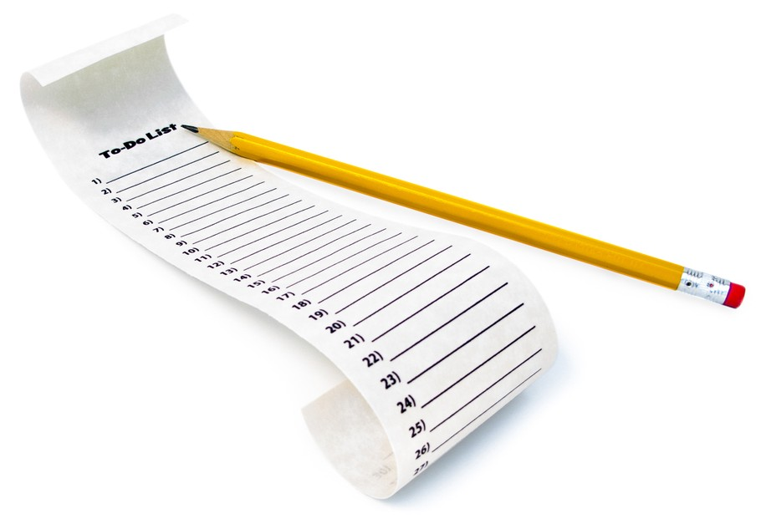
ListViews and Adapters
CIS 399

Slide 2
Course Overview
Wk | Topic
1 | Intro, single-screen apps
1 | Activity Lifecycle, saving activity state
2 | Layouts + widgets, Event Handlers
2 | Themes + styles, Menu + settings
2 | Multi-screen apps
Wk | Topic
3 | Fragments
3 | Reading XML files, Asynch Tasks
3 | List Views
3 | SQLite Database
4 | Consuming a web service
4 | Geolocation

Slide 3

ListViews
Notes:
https://developer.android.com/guide/topics/ui/layout/listview.html

Slide 4
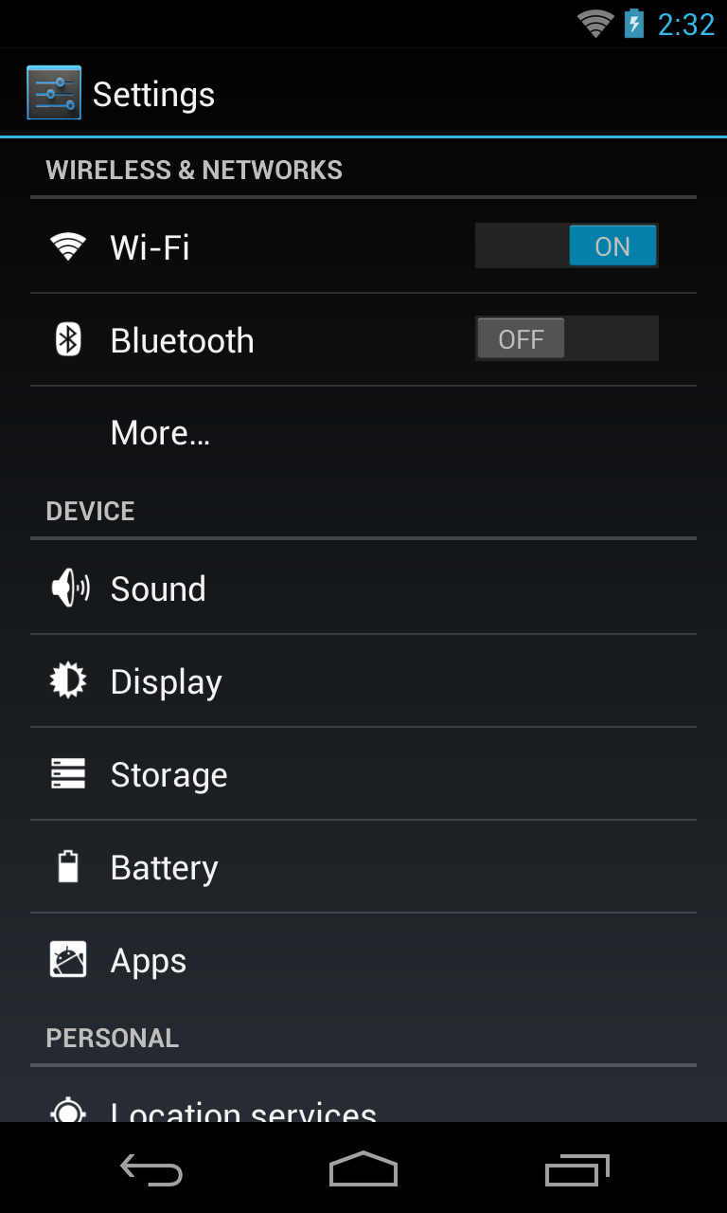
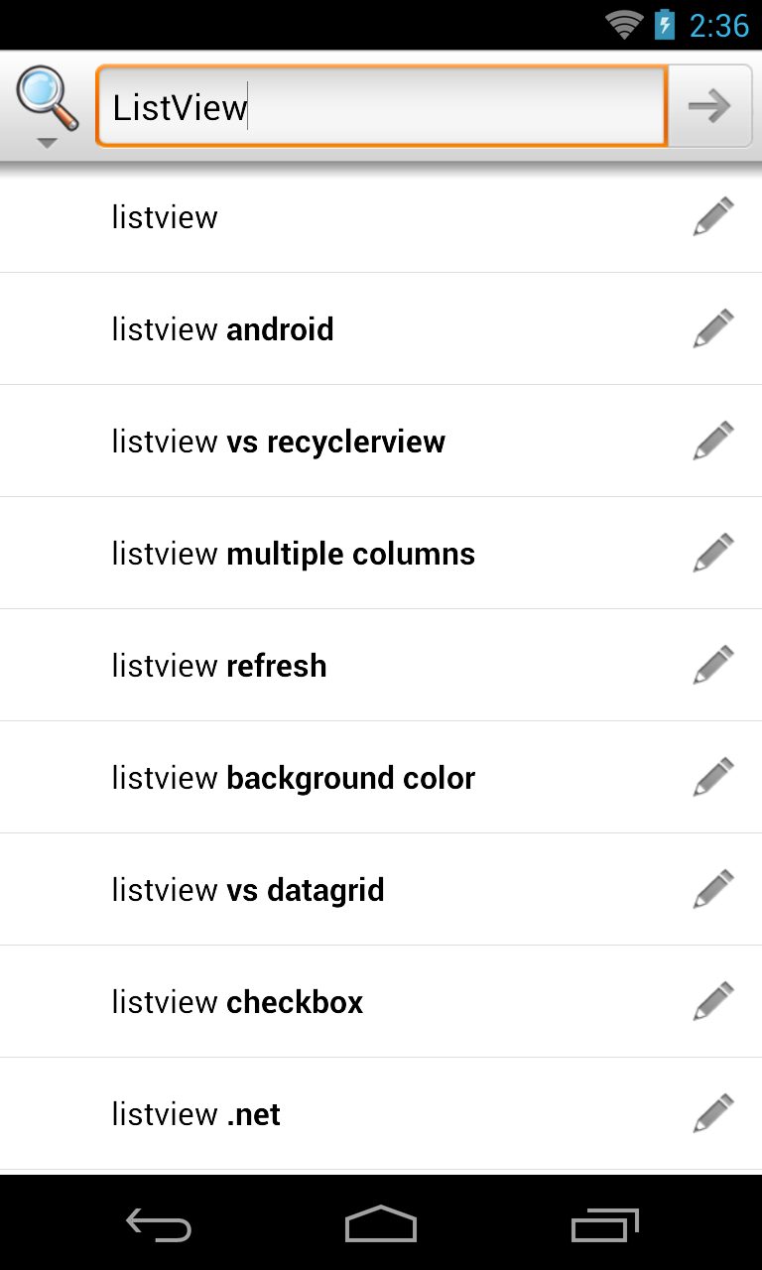
Examples of ListViews

Slide 5
Using a ListView
ListView is a subclass of ViewGroup and can be declared in an XML layout like other UI element.
The ListView displays a list of scrollable rows.
Each row is a View and it’s layout can be defined in an XML layout file.
An Adapter object inserts Items into the ListView. Either pre-defined adapters or custom adapters can be used.

Slide 6
ListView Row Layout
Can be a pre-defined layout from R.layout. For example:
simple_list_item_1
two_line_list_item
See more here: https://developer.android.com/reference/android/R.layout.html
Can be a custom XML layout you define
Notes:
https://developer.android.com/reference/android/R.layout.html

Slide 7
Specifying a ListView Row Layout
The row layout is specified in the constructor for a ListView adapter.
Here’s an example using a custom row layout:
SimpleAdapter adapter = new SimpleAdapter( this, data, R.layout.listview_items, new String[]{IMAGE_NAME, DATE}, new int[]{R.id.iconImageView, R.id.dateTextView} );
Notes:
https://developer.android.com/reference/android/R.layout.html

Slide 8
ListActivity
The ListActivity hosts a ListView object
Screen Layout
A single, full-screen list in the center of the screen.
Customize the layout by setting your own XML layout with setContentView() in onCreate()
Row Layout
The constructor for the ListAdapter hosted by the activity has a parameter for a layout resource
Binding to Data
Done the same way as a ListView-- bind the ListActivity's ListView object to a data source using an adapter
Notes:
https://developer.android.com/reference/android/app/ListActivity.html
Note: the screen layout view and the row layout views could also be created programmatically instead of being defined in XML

Slide 9
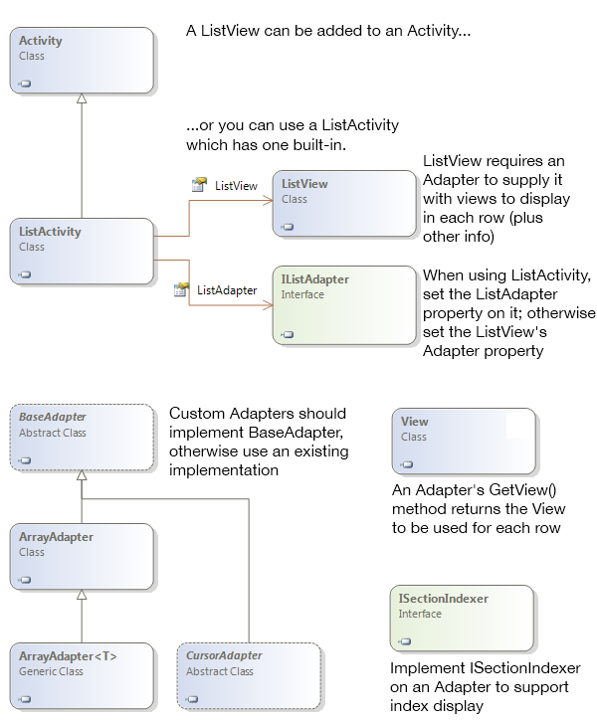
ListActivity Class Diagram

Slide 10
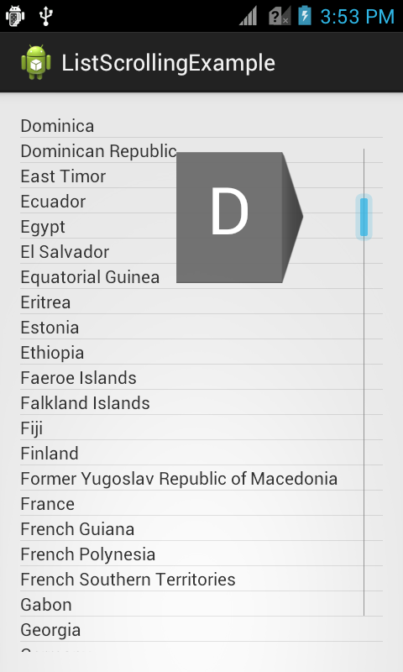
More ListView Features
Fast Scrolling
Dragging a scroll traverses the list
Customizable in API 11 and higher
https://developer.android.com/reference/android/R.attr.html#fastScrollEnabled
Section Index
Section titles appear while scrolling
https://developer.android.com/reference/android/widget/SectionIndexer.htm
Notes:
Reference: https://developer.android.com/reference/android/R.attr.html#fastScrollEnabled
Tutorial: http://androidopentutorials.com/android-listview-fastscroll

Slide 11
Code Tour
Open the Ch. 10 RSS Feed Reader App
In the activity_items layout, look at the ListView XML element.
Look at listview_item layout to see the layout used for the rows in the ListView
Look at the onItemClick event handler

Slide 14
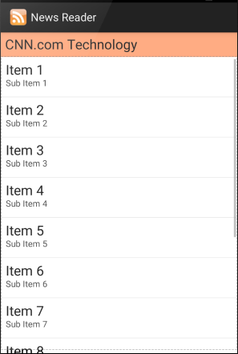
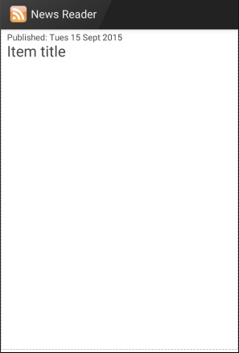

Slide 15
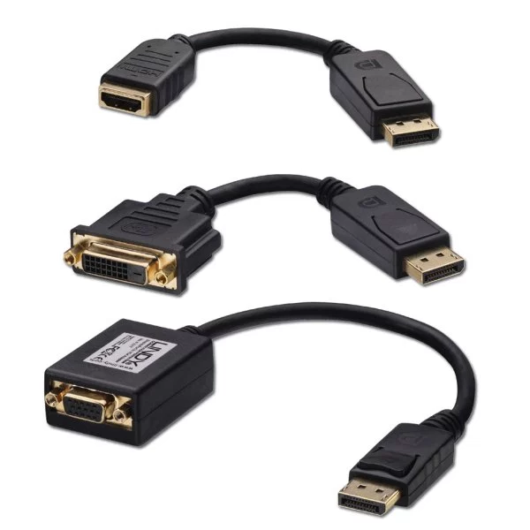
Adapters
Notes:
https://developer.android.com/reference/android/widget/Adapter.html

Slide 16
Adapters
Adapters bind a data source to a ListView
SimpleAdapter – source is an ArrayList of Java HashMap objects
ArrayAdapter<T> – source is an array of type T
SimpleCursorAdapter – source is a SQLite query
BaseAdapter – subclass this to make your own custom adapter

Slide 17
Adapters
Notes:
Doesn’t show SimpleAdapter, but SimpleAdapter extends BaseAdapter and should be shown here.
The Java version’s indexer is named without the I, just SectionIndexer
https://developer.android.com/reference/android/widget/SectionIndexer.html

Slide 18
Using a SimpleAdapter
Can be used with an ArrayList of Maps
Each entry in the ArrayList corresponds to one row in the list
The Maps contain the data for each row
In the activity’s OnCreate method, instantiate a SimpleAdapter object.
Notes:
Android Developers API documentation: https://developer.android.com/reference/android/widget/SimpleAdapter.html

Slide 19
SimpleAdapter Constructor
public SimpleAdapter (Context context,
List<? extends Map<String, ?>> data,
Int32 resource, String[] from, Int[] to)
context: The host Activity context
data: A List of Map<string, ?> objects
resource: ListView layout from Android.Resource.Layout
from: Map key for data source
to: ListView widget property for displaying data
Notes:
https://developer.android.com/reference/android/widget/SimpleAdapter.html#SimpleAdapter(android.content.Context, java.util.List<? extends java.util.Map<java.lang.String, ?>>, int, java.lang.String[], int[])

Slide 20
Code Tour
Open the Ch. 10 RSS Feed Reader App
In the ItemsActivity class, look at the code that creates and sets the adapter.

Slide 24
Further ListView Reading
Using lists in Android (ListView) – Tutorial
by Lars Vogel, 9/29/2015
http://www.vogella.com/tutorials/AndroidListView/article.html#arrayAdapter
Fast scroll and Section indexer tutorial
http://androidopentutorials.com/android-listview-fastscroll
Android Developers ListView Guide
https://developer.android.com/guide/topics/ui/layout/listview.html
Android Developers: Recycler View
https://developer.android.com/guide/topics/ui/layout/recyclerview.html

